Slide 1


Slide 2



FRAUD DETECTION ANALYSIS
“The project aims to enhance the accuracy of detecting fraud in mobile financial transactions. By leveraging machine learning, the project seeks to predict fraudulent transactions with high precision. The goal is to develop a robust machine learning model to accurately identify fraudulent transactions in real-time, enabling the company to improve security, reduce financial losses, and gain insights into factors contributing to transaction fraud.”
Presented By :Divyashree S

Slide 3

INTRODUCTION
Predict fraudulent transactions with high precision in real-time
Strengthen security infrastructure with high financial exposure
Identity fraud indicators through pattern recognition and behavioral analysis
“Success requires balancing detection accuracy with minimal false positives to maintain user trust.”

Slide 4
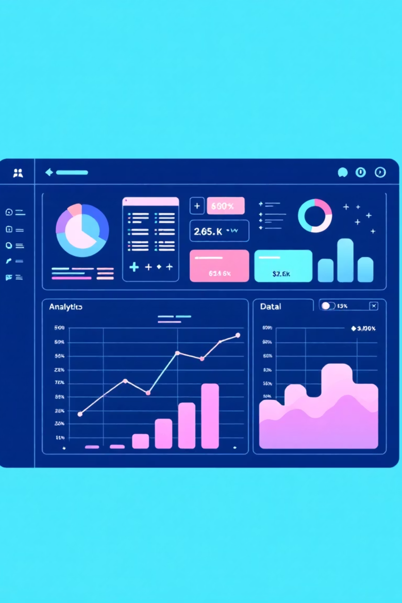
Dataset Overview
11,142
10:1
Total Transactions
Class Imbalance
Records analyzed in the dataset
Ratio of legitimate to fraudulent transactions
The dataset contains transactional records including transaction type, amount, and account balance details. The target variable isFraud indicates whether a transaction is fraudulent (1) or legitimate (0).

Slide 5

EXPLORATORY DATA ANALYSIS
Exploratory Data Analysis (EDA) helped us understand the data structure, find patterns, identify trends, and gain valuable insights from the dataset.
From EDA we analyze, the distribution of each features, checking the correlation between the features .
Using visuals helped us see the data clearly, understand the clinical data relationship with each other, and pinpoint factors that plays vital role in predictions of fraud detection.
The datasets is clean ,as there is no NULL VALUE, and even no DUPLICATE VALUES and OUTLIERS.
We used the univariate and bivariate analysis approach to gain insights into individual characteristics of the data and likewise how each feature relates to main goal: predicting the fraud vs not fraud.

Slide 6
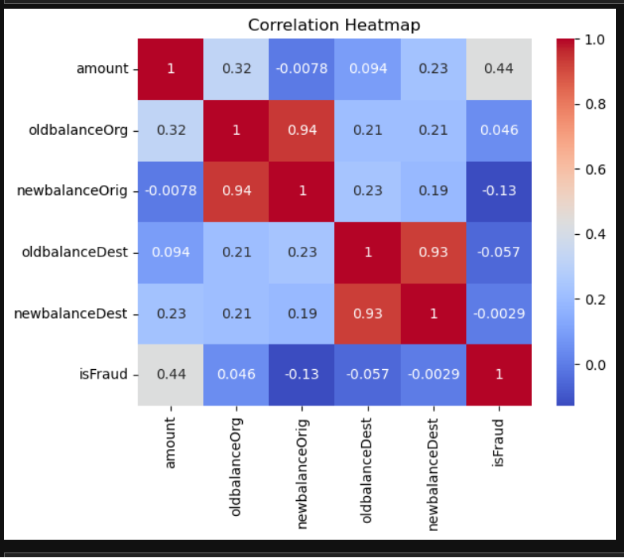
CORRELATION HEATMAP
Visualize relationships between transaction features and the target variable isFraud to guide feature selection and model development.
🎨 Color Interpretation
Red: Strong positive correlation
Blue: Strong negative correlation
Neutral shades: Weak or no correlation
Key Insights
amount has a moderate positive correlation with isFraud (0.44) → High-value transactions may indicate fraud.
newbalanceOrig shows a negative correlation (-0.13) → Fraudulent transactions often leave low balances.
oldbalanceOrg and newbalanceOrig are strongly correlated (0.94) → Indicates consistent behavior in legitimate transfers.
oldbalanceDest and newbalanceDest are highly correlated (0.93) → Reflects stable destination account behavior, weakly linked to fraud.

Slide 7

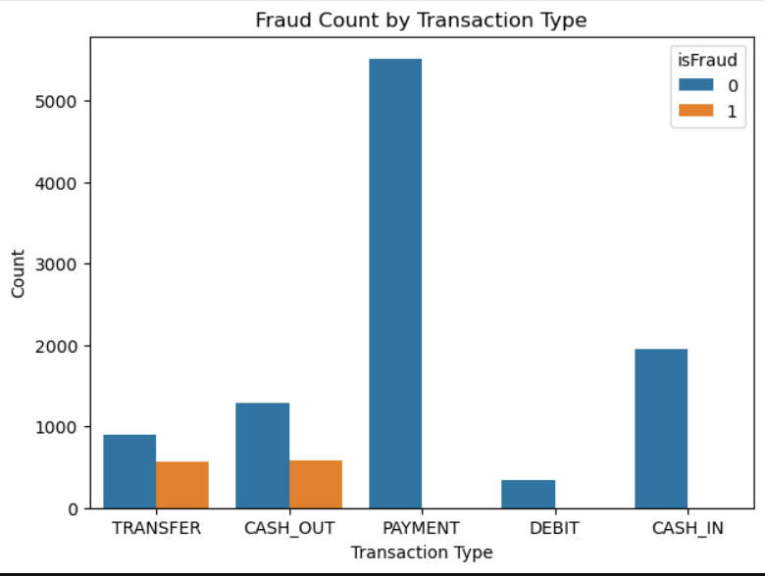
Fraud count by Transaction Type
Targeted Attacks: Fraud is not random; it is 100% concentrated in TRANSFER and CASH_OUT types.
Safe Zones: PAYMENT, DEBIT, and CASH_IN currently show zero fraud activity.
Strategic Focus: By identifying these "hotspots," we can optimize our model to ignore noise and focus purely on high-risk channels.

Slide 8

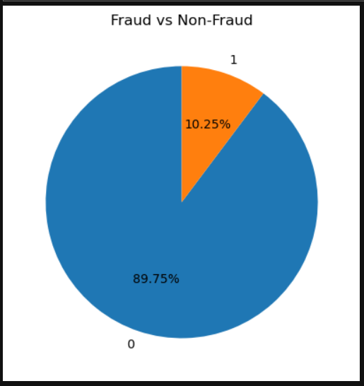
Fraud vs Non-Fraud
System Integrity (89.8%): The vast majority of our ecosystem is healthy. Our priority is to ensure these legitimate customers experience zero friction.
The Financial Threat (10.2%): A significant portion of transactions are fraudulent. Without intervention, this "needle" represents a direct threat to revenue and platform trust.
The ML Solution: Our XGBoost model acts as a surgical filter—identifying and neutralizing the 10% risk with 99.6% accuracy without impacting the safe 90%.

Slide 9

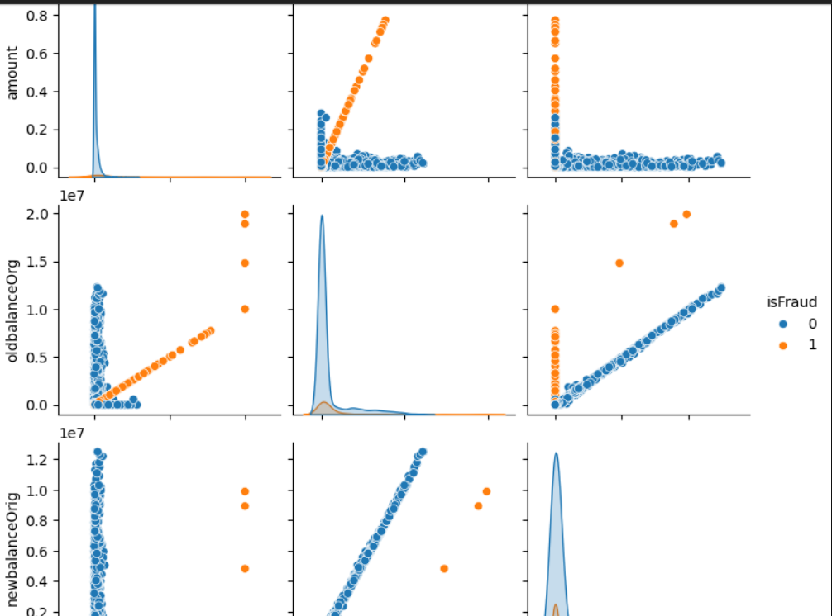
Multivariate Feature Interactions Highlighting Fraud Patterns
Correlation Clusters: The Pairplot reveals that fraud is not random; it forms distinct, visible clusters in specific financial dimensions.
The "Drain" Pattern: A key discovery shows fraud dots clustering where 'Amount' exactly matches 'OldBalanceOrg'—a clear sign of accounts being emptied systematically.
Feature Interaction: Fraudulent activity is tied to specific relationships between account balances rather than just high transaction amounts.
Model Validation: These visible patterns confirm that our features are highly predictive, explaining why the XGBoost model achieved near-perfect accuracy.

Slide 10
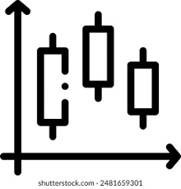
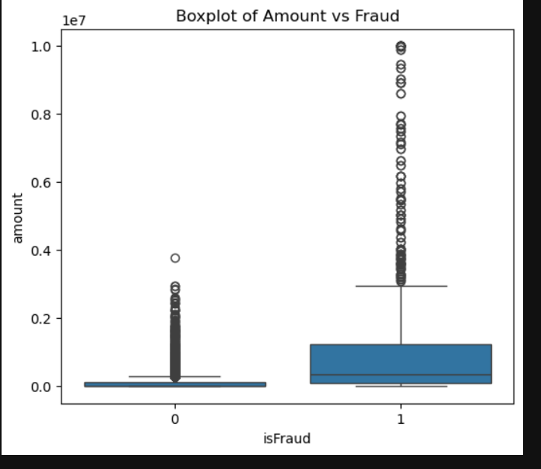
Box Plot of Amount vs Fraud
The "Spending Habit" Contrast: Legitimate users stay within a small, predictable range. Fraudsters operate in a much higher, volatile financial bracket.
Median Shift: The middle-point (Median) for fraud is significantly higher, creating a clear "Detection Zone" for the model.
Scale of Impact: Safe transactions appear flat because their values are negligible compared to the massive scale of individual fraud attempts.

Slide 11




Feature Engineering
Balance Differences
Encoding
Scaling
Created features comparing old vs new balances for origin and destination accounts
Categorical variables transformed for model compatibility
Numerical variables normalized using OneHotEncoder

Slide 12




MODEL SELECTION
Random Forest
Logistic Regression
Random Forest: Random Forest is a robust supervised algorithm suitable for both regression and classification tasks.
Logistic regression is used for binary classification. It models predictors to estimate the probability of an outcome.
XGBoost
Gradient boosting framework optimized for imbalanced datasets with superior performance

Slide 13

Data Preprocessing & Modeling
Raw Data
Remove duplicates & null values
OneHotEcoder
Model Training
PipeLine Scaling

Slide 14
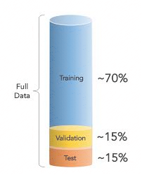
TRAIN TEST SPLIT
We divided the data into training (80%) and testing (20%) sets.
Setting a random state ensures consistent results and using stratify=y maintains a proportional distribution of the target variable in both sets.
SPLITING THE DATA INTO X & Y
We divided the dataset into two parts: X and y.
"X" typically represents the independent Variables, and "y" represents the Dependent (target variable) that we want to predict or understand.

Slide 15
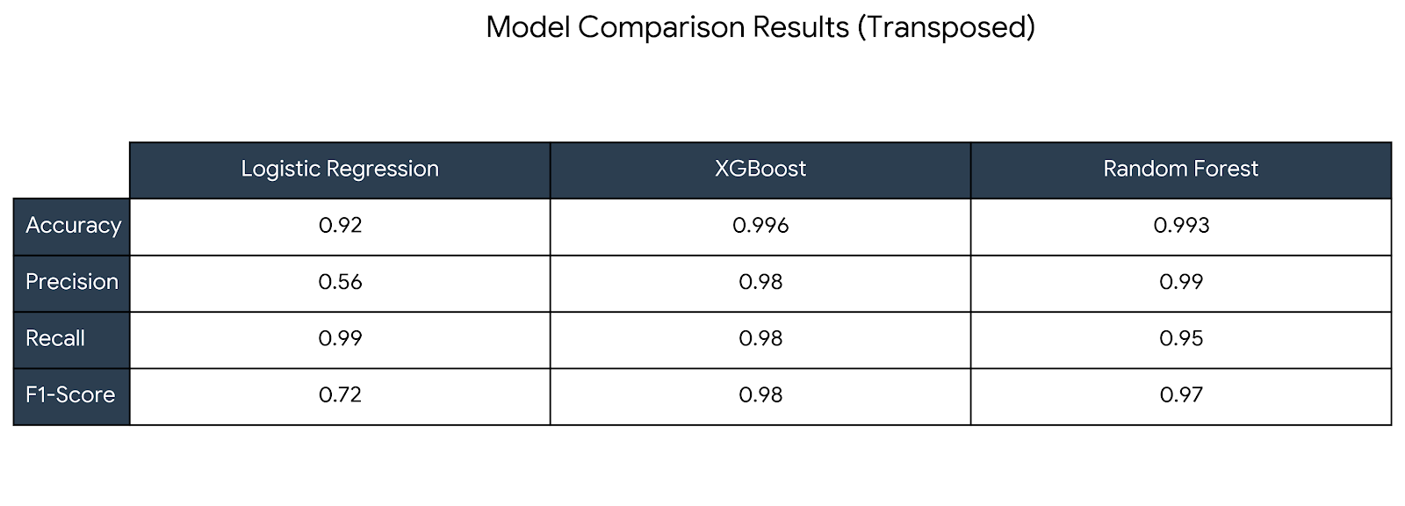
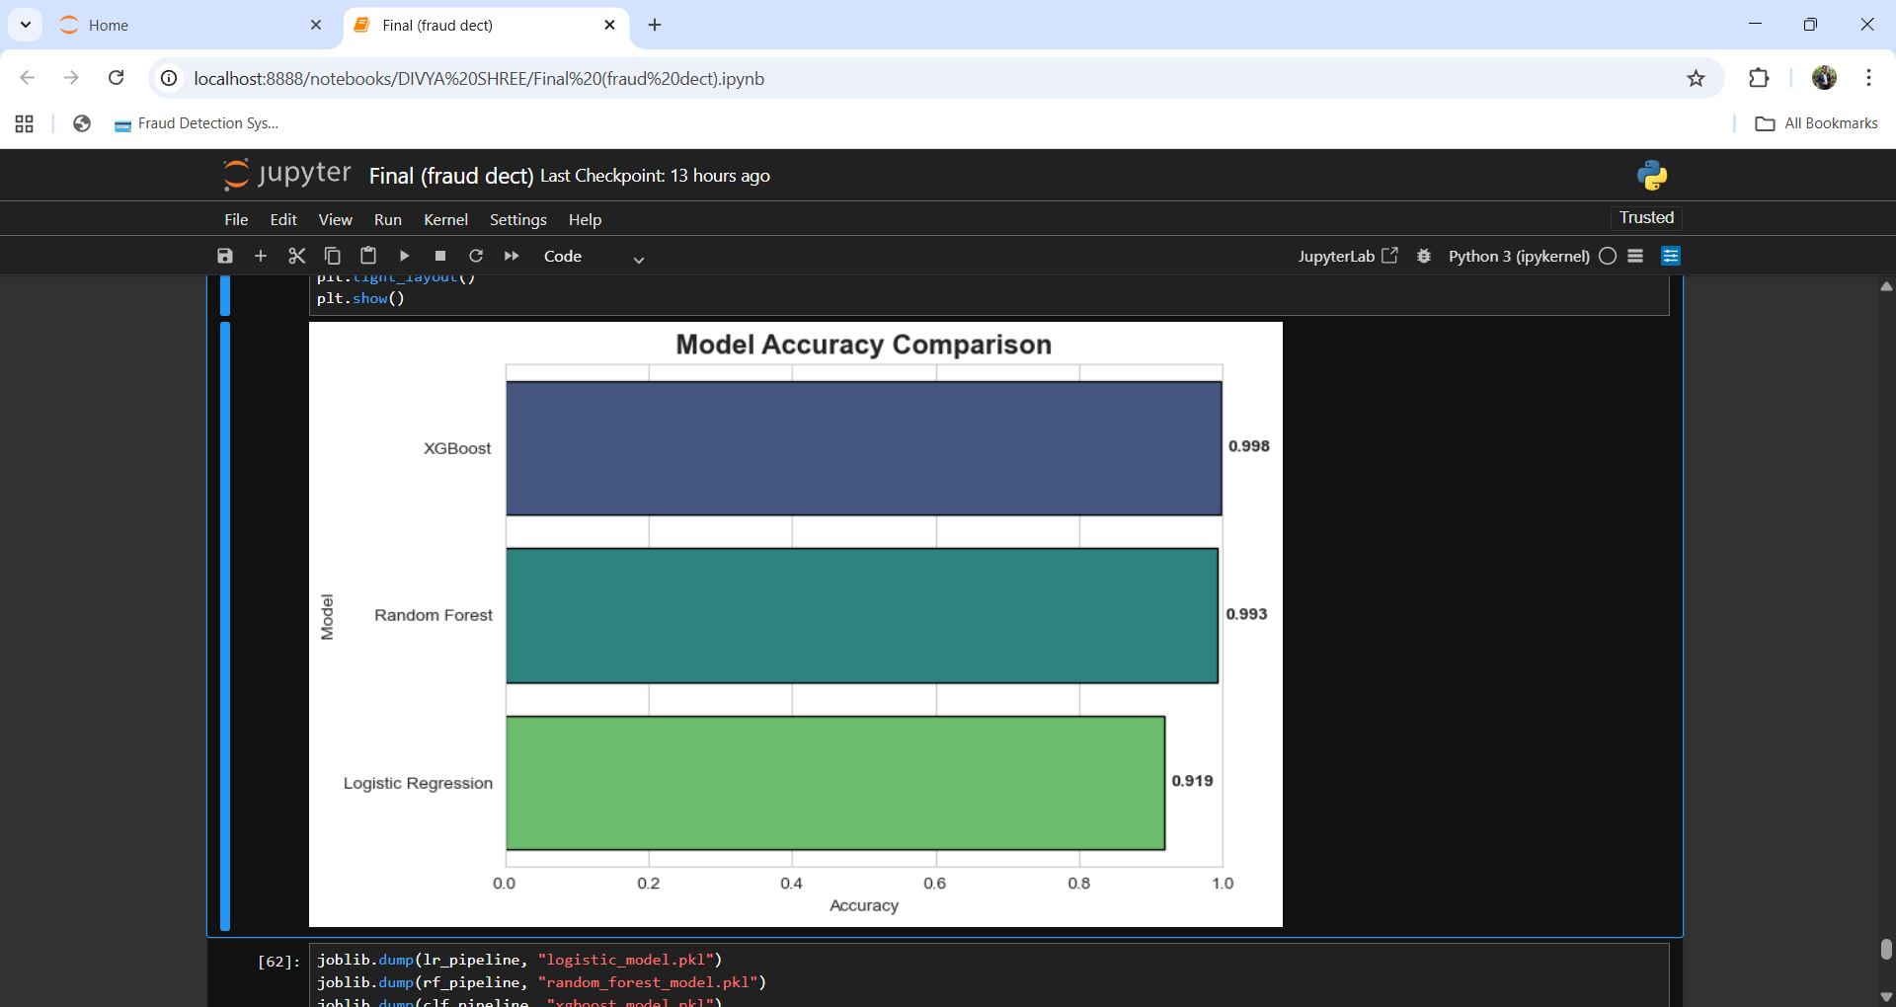
Output
Best Overall Performer: XGBoost achieved the highest balance across all metrics, with a near-perfect F1-Score (0.98) and Accuracy (0.996).
Reliability: Random Forest closely followed XGBoost, maintaining high Precision (0.99) but slightly lower Recall.
Precision : While Logistic Regression has excellent Recall (0.99), its low Precision (0.56) indicates a high number of False Positives.
Strategic Recommendation
Select XGBoost for production. It provides the most robust predictions with the fewest errors (highest F1-score), making it significantly more dependable than the baseline Logistic Regression model.

Slide 16



Conclusion
Key Findings
Best Model: XGBoost is the superior choice, delivering 99.6% accuracy and a near-perfect balance of precision and recall.
Fraud Hotspots: Fraudulent activity is exclusively concentrated in TRANSFER and CASH_OUT transactions.
High Sensitivity: All models successfully identified over 95% of fraud cases, ensuring high security.
Limitations
Sample Size: Results are based on a small dataset (~11k records); performance needs validation at scale.
Feature Gaps: Absence of geographic and temporal data (time/location) limits detection of complex fraud patterns
False Positives: High recall in simpler models (Logistic Regression) leads to excessive "false alarms" for customers

Slide 17


